Slide 1

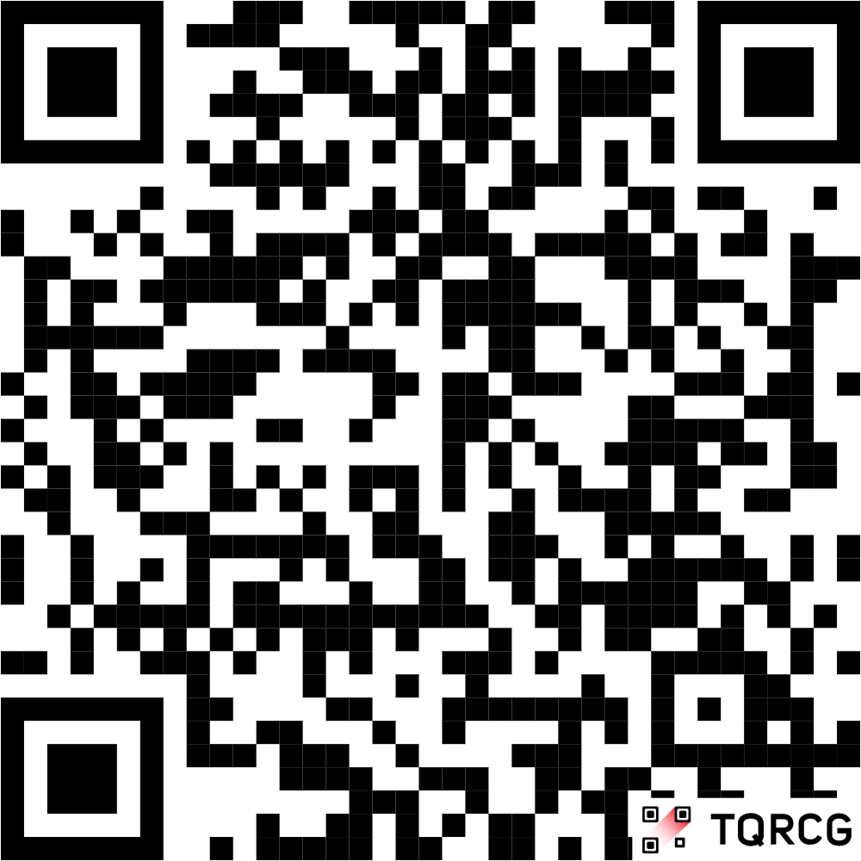
SafeCity: Report. Track. Fix.
Empowering Citizens to Build Safer Communities
Developer: Uwami Mgxekwa
SCAN QR CODE TO OPEN SafeCity APP
https://uwami-mgxekwa.github.io/SafeCityWeb/

Slide 2


The Johannesburg Infrastructure Challenge
Infrastructure issues are a daily reality in Johannesburg, leading to frustration and safety hazards. The current reporting landscape is fragmented, inefficient, and lacks transparency.
Infrastructure Decay
Citizen Frustration
Lack of Transparency
Potholes, water leaks, and non-functioning traffic lights cause property damage, waste resources, and create dangerous traffic situations.
Citizens face long response times, no centralized system, and significant difficulty tracking the status of their reported issues.
There is no visibility into whether reports are received, what action is being taken, or the overall resolution progress.
https://uwami-mgxekwa.github.io/SafeCityWeb/

Slide 3





SafeCity: The Progressive Solution
SafeCity is a Progressive Web App (PWA) designed to bridge the gap between engaged citizens and local authorities, fostering accountability and rapid response.
Interactive Mapping
GPS + Photo Proof
Community Dashboard
GPS-enabled mapping allows users to pinpoint exact issue locations for accurate reporting.
Documenting issues with photographs and GPS coordinates provides clear, undeniable evidence.
See real-time statistics, upvote existing issues, and track community-wide resolution progress.
SCAN QR CODE TO OPEN SafeCity APP
Instant Notifications
Offline Capability
Stay informed with automated status updates via Email and WhatsApp messaging.
The PWA design ensures users can file reports even without an internet connection, syncing later.
Screenshots available on the live site: https://uwami-mgxekwa.github.io/SafeCityWeb/

Slide 4
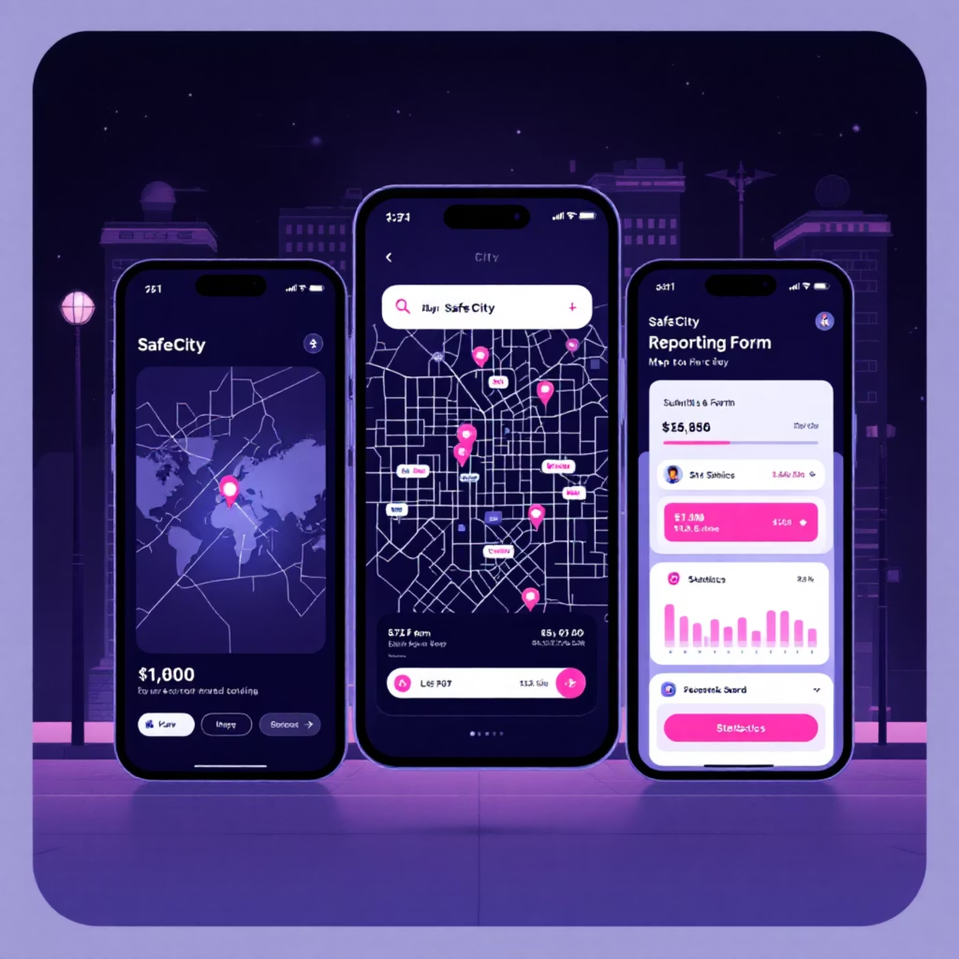
Experience SafeCity Now! 🚀
Scan or Visit to Try the Demo
Scan the QR Code
The Progressive Web App works seamlessly on any device (phone, tablet, or desktop) and requires no installation.
Report issues in just 3 clicks
See a real-time map of local problems
Track your community's positive impact
https://uwami-mgxekwa.github.io/SafeCityWeb/
🔗 uwami-mgxekwa.github.io/SafeCityWeb/

Slide 5



Sustainable Business Model & Growth Strategy
Revenue Streams
Target Customers
Government Subscriptions: Premium analytics, advanced tools, and custom integrations for municipal partners.
Our focus is on securing partnerships across three key segments:
Primary: Municipal Governments (e.g., City of Johannesburg).
Corporate Partnerships: Sponsorships for issue resolution and brand visibility through CSR initiatives.
Secondary: Infrastructure Maintenance Companies.
Tertiary: Community Organizations & NGOs.
Data Insights: Anonymized data on infrastructure trends for urban planning and predictive maintenance.
Growth Trajectory
Phase 1
Phase 2
Phase 3
Launch & Stabilization in Johannesburg (Current)
Expansion to key South African metros: Pretoria, Durban, Cape Town
National Rollout and adoption across South Africa
https://uwami-mgxekwa.github.io/SafeCityWeb/

Slide 6
Security and Compliance: Built on Trust
SafeCity is built using a Secure Software Development Lifecycle (SSDLC), prioritizing user data protection and privacy compliance from the ground up.
Robust Security Measures
Privacy & Compliance
Auth & Encryption: Supabase Auth, encrypted passwords, and secure session management.
GDPR-Compliant data handling.
Data Protection: HTTPS for all comms, parameterized queries (SQL injection prevention), and input validation.
User Control: Optional photo uploads and controlled location sharing.
Testing: Rigorous cross-browser, mobile responsiveness, security penetration, and community-led UAT.
Transparency: Clear policies on data export, deletion rights, and usage.
https://uwami-mgxekwa.github.io/SafeCityWeb/

Slide 7
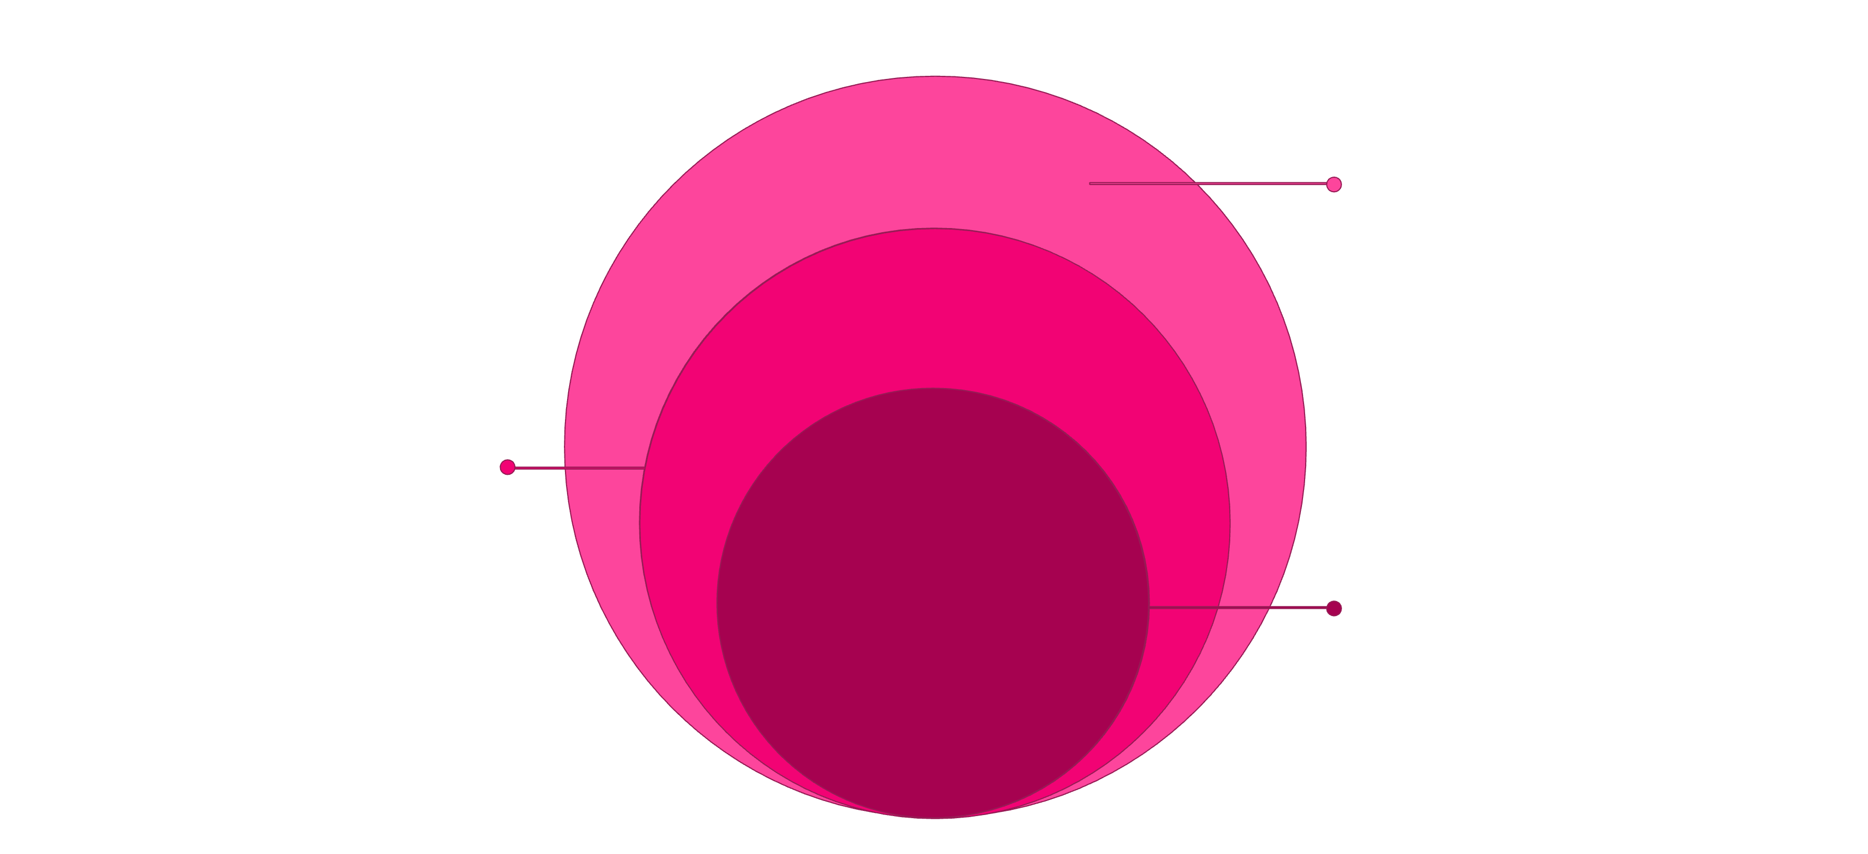
Technical Architecture & Stack
SafeCity utilizes a modern, modular architecture, ensuring high performance, scalability, and maintainability.
Data Layer
PostgreSQL: Users, Reports, Stats
Service Layer
Supabase, EmailJS, WhatsApp API
Client Layer
Web App and PWA interfaces
Core Tech Stack
API Integration
https://uwami-mgxekwa.github.io/SafeCityWeb/
Frontend: HTML5, CSS3, JavaScript (ES6+)
Supabase: Real-time database operations for instant updates.
Database: Supabase (PostgreSQL)
EmailJS: Automated status and activity notifications.
Authentication: Supabase Auth
Browser APIs: Leveraging Geolocation and MediaDevices for seamless reporting.
Notifications: EmailJS
PWA: Service Worker API

Slide 8








Measurable Impact & Scalability
SafeCity is designed to generate significant, measurable impact through streamlined community engagement and data-driven governance.
Faster Response
Increased Engagement
Expected 30-50% improvement in infrastructure response times due to accurate, instant reporting.
User authentication and personalized dashboards drive higher citizen satisfaction and participation.
Accountability
Data-Driven Planning
Public status tracking (New → Resolved) ensures transparent and accountable governance.
Real-time data feeds inform city officials for proactive maintenance and better resource allocation.
Scalability Built-In
The modular architecture and cloud-based infrastructure ensure SafeCity is ready for multi-city expansion and future government API integration.
https://uwami-mgxekwa.github.io/SafeCityWeb/

Slide 9
Roadmap for Growth
✅ Current Features (Live)
1
User Auth, GPS/Photo Reporting
Interactive Map & Real-time Stats
Email/WhatsApp Notifications, Offline PWA
2
📅 Next 3 Months (Q1 2025)
Push Notifications for status updates
Multi-language support (Zulu, Afrikaans, Sotho)
📅 6-12 Month Vision (2025)
3
AI-powered issue classification
Government API integration (City of Johannesburg)
Native mobile apps (iOS & Android)
Predictive Maintenance using ML
Expansion to Pretoria, Durban, Cape Town
Advanced Analytics Dashboard for officials
https://uwami-mgxekwa.github.io/SafeCityWeb/

Slide 10




Join Us in Building Safer Communities!
SafeCity is an open-source initiative seeking partners to maximize our impact across South Africa and beyond.
Government Partnerships
Collaborate for official integration and implementation.
Investment Opportunities
Help us scale through key investment and funding.
Open Source Contributors
Join the community and contribute to the code base.
Developer Contact
Developer: Uwami Mgxekwa
Live Demo: uwami-mgxekwa.github.io/SafeCityWeb/
Open Source: github.com/Uwami-Mgxekwa/SafeCityWeb

